Slide 1
Stat 231 Midterm 1 Review
Fall 2024

Slide 2
Hi I’m Andy
For later questions about this slide deck, you can find me on the UW Stats Club discord server. My handle is @andoiii
This slide deck will be posted on the discord server after today’s session. If this doesn’t happen, please ping me and I will do it promptly.
Remember: You can do it! I believe in you, so you better believe in yourself too. Or else.
3rd Year CS/BBA
STAT 240 (F23)
STAT 231 (S24)
Constantly regressing
not a Laurier spy

Slide 3
The Plan for Today
Chapter 1: Intro to Stats
Chapter 2: MLEs
Empirical Studies
Review: Common Models
Numerical Data Summaries
Point Estimates: $\hat{θ}$
Graphical Data Summaries
$L\left(θ\right), R\left(θ\right), l\left(θ\right), r(θ)$
Probability Models
The Invariance Property
Checking Model Fit
QQ Plots

Slide 4
The Plan for Today
Terms and Review
Model Fit
Empirical Studies
QQ Plots
Probability Models
Checking Model Fit
MLEs
Review: Common Models
Graphs
Point Estimates: $\hat{θ}$
Graphical Data Summaries
$L\left(θ\right), R\left(θ\right), l\left(θ\right), r(θ)$
Numerical Data Summaries
The Invariance Property
We also do Sample Midterms

Slide 5
!! IMPORTANT NOTICE !!
I took the course in the Spring term. Some of the content we did not cover, and thus I don’t feel fully qualified to teach correctly.
To avoid giving bad information, I will simply give no information. Sorry :(
This notably includes R.
Not competent enough at R to teach it
But competent enough to put it on the resume
A very low bar.
Idiot ->

Slide 6
terms and review

Slide 7
Empirical Studies
An empirical study aims to gain knowledge by observation or by experiment. A key feature is the involvement of uncertainty.
Empirical studies look at populations or processes, gathering data on variates to examine questions about attributes.
Empirical Studies come in 3 major formats – Sample Surveys, Observational Studies, Experiments

Slide 8
Populations, Processes, Units
Populations and Processes are made up of units – an individual “thing” that we can take measurements on.
Populations are simply a collection of units, defined at a static point in time.
Processes are also collections of units but produced over time. They are also defined as a system by which units are produced.

Slide 9
Variates
Variates are characteristics of the units. They are usually given a letter to describe it.
$$≠$$
Flavour Categorization
Function? Categorization
Continuous
Discrete
Categorical
Binary
Ordinal
Complex
Explanatory
Response

Slide 10
Attributes
Attributes are functions of a variate, which is defined for all units in the population or process.
For example, it may be an average increase/decrease, proportion, variance measure, average, and so on.
IMO, Attributes make raw data nicer to deal with, especially the average. (See: Central Limit Theorem)

Slide 11
Types of Studies
Sample Surveys select a representative sample of units from the population and determine variates of interest. It also usually involves a survey – active collection.
Observational Studies gather information without attempting to change any variates in the sampled units – passive monitoring.
Experiments have the researcher intervene, changing/setting the values of variates in the survey – active control.
All studies involve randomization in selection or assignment.

Slide 12
Probability Models
Discrete Models
Continuous Models
Binomial
Negative Binomial
Multinomial
Poisson
Normal/Gaussian
Exponential
Refer to STAT 230/ the STAT 231 Course Notes for the respective PDFs/CDFs

Slide 13
graphs

Slide 14
Measures of Location
The sample mean is the arithmetic average of the observations. It is easy to do math on; but tends to be skewed by outliers.
The median is the “middle” observation, when ordering them in increasing order. If there isn’t a single term being the middle, take the average of the 2 “middle” observations.
The mode is the most frequently observed observation(s). You can have multiple modes, yes. Modal classes also exist.

Slide 15
Percentiles and Quartiles
Percentiles generalize the concept of medians. $\hat{m}=q(0.5)$.
In general, the $p^{th}$ percentile is $y_{(p\left(n+1\right))}$, where $n$ is the number of terms. If you get a fraction in the ordinal index, take an average between the 2 closest terms.
We also have the lower quartile $q\left(0.25\right)$, and the upper quartile $q(0.75)$.

Slide 16
Measures of Spread
Sample Variance is denoted with $s^{2}$ and is calculated as
$$s^{2}=\frac{1}{n−1}\sum_{i}{{\left(y_{i}−\overline{y}\right)}^{2}}=\frac{1}{n−1}\left[\sum_{i}{{y_{i}}^{2}−n{\overline{y}}^{2}}\right]$$
Sample Standard Deviation is $s=\sqrt{s^{2}}$, the square root of variance. Don’t forget to take the square root I swear
Also: Empirical Rule for Unimodal Symmetric Data – 68,95,99.7

Slide 17
Measures of Spread
Range is the difference between the largest and smallest observations, or $y_{(n)}−y_{(1)}$
IQR is $q(0.75)−q(0.25)$. This is the range of the middle half of observations.

Slide 18
The 5 Number Summary
$$y_{\left(1\right)},q\left(0.25\right), \hat{m}, q\left(0.75\right), y_{(n)}$$

Slide 19
Measures of Shape
Skewness is how asymmetrical the data is.
Positively skewed means a right tail
Negatively skewed means a left tail
Approximately 0 skewness is a symmetric distribution.
$$g_{1}=\frac{\frac{1}{n}\sum_{i}{{\left(y_{i}−\overline{y}\right)}^{3}}}{{\left[\frac{1}{n}\sum_{i}{{\left(y_{i}−\overline{y}\right)}^{2}}\right]}^{3/2}}$$
The absolute value of $g_{1}$ denotes how “skewed” the distribution is.

Slide 20
Measures of Shape
Kurtosis is how “centrally concentrated” a distribution is.
$<3$ indicates lighter tails, no tails, and a flat center (uniform)
$>3$ indicates heavier tails, and a peaked center (t-distribution)
Empirically, Gaussian-looking distributions have $g_{2}≈3$
$$g_{2}=\frac{\frac{1}{n}\sum_{i}{{\left(y_{i}−\overline{y}\right)}^{4}}}{{\left[\frac{1}{n}\sum_{i}{{\left(y_{i}−\overline{y}\right)}^{2}}\right]}^{2}}$$
We also have platykurtic ($<3$) and leptokurtic ($>3$). They exist.

Slide 21
Graphs
We love graphs. However, remember:
Style counts. Make it look decent and readable
Title graphs, label axis, give units, use good scales.
Bring a ruler! If they allow you to. A WatCard works lol
We will go over some graphs, and how to make them. I will be using the blackboard for these mostly.

Slide 22
Histograms
They display the frequency of observations within intervals, partitioning the range of observed data into some number of intervals.
Standard Frequency Histograms have equal width intervals, so if the interval width is 1, all rectangle heights are equal to the number of observed frequencies.
Relative Frequency Histograms have unequal width intervals, so that AREA of each rectangle is the % of data observed in that interval.

Slide 23
Histograms
Here, let me draw some histograms with this data:
Interval | $$[0,10)$$ | $$[10,20)$$ | $$[20,30)$$ | $$[30,40)$$ | $$[40,50]$$
# Frequencies | 7 | 11 | 17 | 20 | 1

Slide 24
Bar Charts and Pie Charts
Bar Charts look like histograms, but usually have no meaning in the x-axis. They are usually used to show values in a certain category. Side-by-Side Bar Charts/Stacked Bar Charts also exist.
Pie Charts use “slices of pie” to represent percentages. Supposedly, most professionals don’t like Pie Charts.

Slide 25
Bar Charts and Pie Charts

Slide 26
Empirical CDFs
We graph the function $P(Y≤y)$ for our given observations. In other words,
$$\hat{F}\left(y\right)=\frac{\# Observations≤y}{n}$$
This will look like a step function, with steps occurring at wherever we observe a given datapoint, with step sizes of $1/n$, save for repeated observed data.

Slide 27
Empirical CDFs
For example, let us plot the Empirical CDF for 5 observations:
$$1,1,2,3,5$$

Slide 28
Boxplots
Boxplots are the most complicated to draw, but provide data on range and skewness. You also see it in financial graphs, though I do not fully grasp it’s use there.
Side by side, they are useful for comparing multiple groups to each other.

Slide 29
Boxplots
Draw lines for $q\left(0.25\right), \hat{m}, q(0.75)$. This forms the main section of the box.
Determine the Upper Limits and Lower Limits
$UL=q\left(0.75\right)+1.5×IQR$ | $LL=q\left(0.25\right)−1.5×IQR$
The closest observations to UL and LL that are “within the center range) become the whiskers
Any points outside beyond the whiskers are outliers
$$×$$
$$×$$
$$×$$

Slide 30
Run Charts and Scatterplots
Run Charts are good for examining how data acts over time. Think of it as a very wiggly line mapping data over time.
Scatterplots plot bivariate data, unlike the rest which plot univariate data. Observation points $(x_{i},y_{i})$ are plotted.

Slide 31
One More Numerical Summary…
Sample Correlation measures linear correlation between 2 variates. A full formula and alternative forms are on the formula sheet.
$$r=\frac{S_{xy}}{\sqrt{S_{xx}S_{yy}}}$$

Slide 32
Interpreting Sample Correlation
Positive Correlation means a positive linear relationship
Negative Correlation means a negative linear relationship
Approximately 0 Correlation means no linear relationship
Correlation never implies causation, by itself!
Other non-linear relationships can exist, and not be reflected by $r$. For example, if there is a quadratic relation, we can still have $r≈0$.

Slide 33
Relative Risk (I lied)
When given a 2-way table, you can calculate relative risk which is a nice 1 number summary on the relative conditional probabilities.
For instance, the Relative Risk for Option 1 in Group 1, compared to Group 2:
 | Group 1 | Group 2
Option 1 | $$a$$ | $$b$$
Option 2 | $$c$$ | $$d$$
$$\frac{P\left(Option 1 \right| Group 1)}{P\left(Option 1 \right|Group 2)}=\frac{a/{(a+c)}}{b/{(b+d)}}$$

Slide 34
model fit

Slide 35
QQ Plots
QQ Plots plot the actual quantiles obtained from Empirical data over the theoretical quantiles of a Gaussian distribution. The data points are $Q_{z}\left(\frac{i}{n+1}\right), q(\frac{i}{n+1})$. Remember, these are just labels for actual numbers!
If the data came from a Gaussian distribution, we would expect the plotted data to follow a reasonably straight line.
QQ Plots let us identify whether the sample is Gaussian or non-Gaussian.

Slide 36
The 4 QQ Plot Shapes you must know
Skewed - Positive
Skewed - Negative
With a right tail, the higher quantiles will be much higher than we would expect. The lower quantiles would “bunch up” on the y-axis.
Thus, we would get a U-shaped curve, concave up.
With a left tail, the lower quartiles will be much lower than expected. The higher quartiles instead “bunch up” on the y-axis.
Thus, we would get a S-shaped curve, concave down.

Slide 37
The 4 QQ Plot Shapes you must know
Kurtosis – Flat and No Tails
Kurtosis – Spiked and Big Tails
With no/little tails, our both the lower quartiles and the upper quartiles with “flatten out” as all the theoretical quantiles share the same actual value.
Thus, we would get a S-shaped curve.
With thick tails, we would see more observations than expected on the right, and less observations than expected on the left, especially with outliers.
Thus, we would get a N-shaped curve.

Slide 38
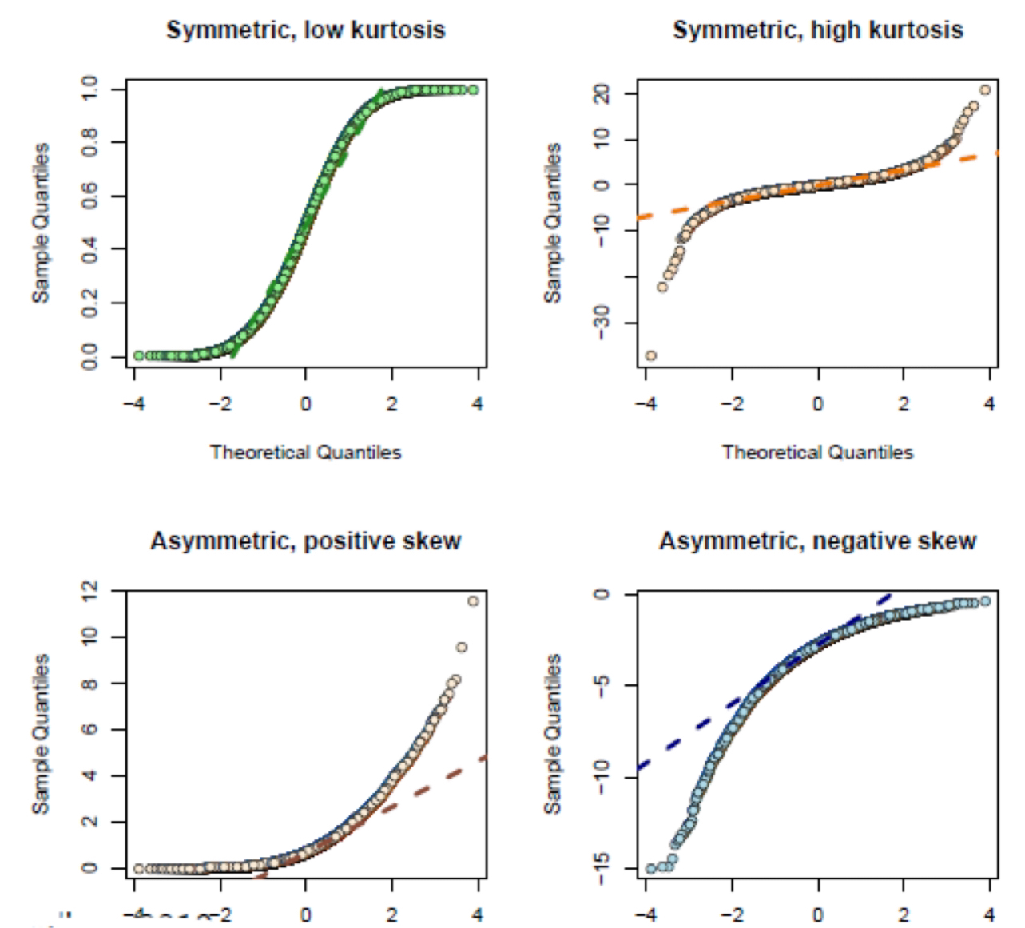
The 4 QQ Plot Shapes - Summary
Source: Lecture Slides from Chelsea Uggenti, STAT 231 Spring 2024

Slide 39
Describing Model Fit
You can compare data to each other, and model fit in general, using any of the numerical or graphical summaries described for the past while.
For example, checking if data fits a Gaussian model:
Whether the sample means and medians are similar, implying symmetry
Skewness being close to 0, kurtosis being around 3
About 95% of the observations lie within $2σ$ of the mean
A histogram looks aligned to a PDF overlain on top.
The line on a QQ Plot looks relatively straight.

Slide 40
Expected Frequencies
We can compare expected frequencies to observed frequencies and (for now) roughly see if the data matches up or not.
To calculate an expected frequency, simply do:
$$e_{S}=n×P(Y∈S)$$
Where $n$ is the number of observations, and $S$ is either a number (if discrete) or some interval in general.
Remember to un-censor your data – most PDFs are defined on all reals – including the infinities! Expected frequencies must add to 1, so you must account for that.

Slide 41
mle

Slide 42
Maximum Likelihood Estimate
After fitting a model to the data (or, uh, assuming it fits), we need to estimate the parameters to that model. For now, this is where we can use the MLE.
For a given parameter $θ$, the estimate based off the data is denoted as $\hat{θ}$. The general formula, the estimator, is denoted $\tilde{θ}$.
You should probably know the MLEs for the most common models (Binomial, Gaussian, Poisson, etc.)

Slide 43
Getting MLEs
We define $\hat{θ}$ to be the value that maximizes the probability of us getting the data we got. If $Y$ is a random vector, and $y$ is the observations from that, we aim to maximize $P(Y=y; θ)$
We define the likelihood function $L(θ)$ to be $P(Y=y; θ)$ for discrete data. For continuous data, use PDFs $f(y_{i};θ)$
Thus, we want to maximize $L\left(θ\right)$, which now becomes a calculus problem!
For some distributions, you may have to verbally argue why it is a maximum (ex. $Uniform(0,θ)$ has $\hat{θ}=y_{(n)}$)

Slide 44
The Usual Process
Write out the likelihood function $L(θ)$
If you have a vector of observations, you probably need $\prod{L(Y=y_{i};θ)}$
Because we hate the product rule, take the logarithm, and work on $l\left(θ\right)=\log{L(θ)}$
Differentiate $l\left(θ\right)$, getting $l′(θ)$
Finally, $\hat{θ}$ is the value such that $l^{′}\left(\hat{θ}\right)=0$ from the First Derivative Test*.

Slide 45
Invariance
Invariance allows you to find “derivative” MLEs for other functions involving a MLE.
If $\hat{θ}$ is the MLE for $θ$, then $g(\hat{θ})$ is the MLE for $g\left(θ\right)$.
Use cases: specific probabilities, the median, the IQR, expected values/frequencies, etc.

Slide 46
midterm

Slide 47
Tips for the Midterm
The questions tend to be sneaky – be careful reading and think through questions logically. Inference may be needed.
Carefully define units! Timing, location, etc.
Practice taking some derivatives of PDF/CDFs.
This slide deck is not 100% inclusive – check your notes on what’s missing

Slide 48
And now, lets look at some midterms

Slide 49
good luck bye

